Slide 1
Tableau Review
Monica Crable

Slide 2
Overview:
Joins, Relationships, Unions
Data Types
Organizing Data
Chart Types
Marks Card
Aggregations and Calculated Fields
Analytics Tab
Dashboards

Slide 3
Joins, Relationships, Unions
Joins : Similar to joins in SQL, creates one mega-table; inner, left, right, full outer; strong, yet rigid connection, possible duplication of data; “physical layer”
Relationships: Default method and used most of the time; orange “noodle”; tables are loseley joined and their original structure is maintained; flexible relationship; “Logical layer”
Unions : takes tables with similar fields and “stacks” them on top of each other, creating one large table.

Slide 4
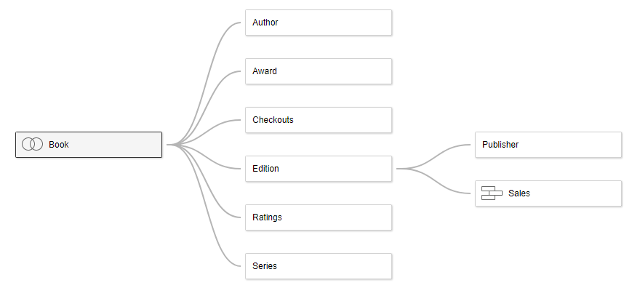
Relationships

Slide 5
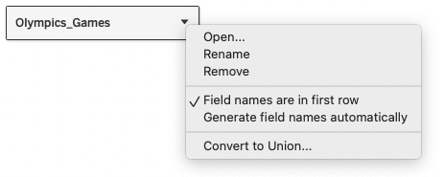
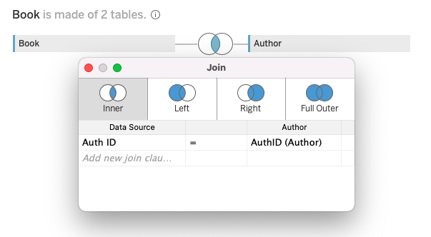
Joins

Slide 6
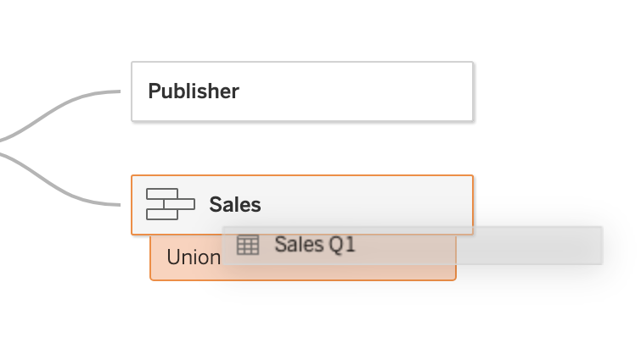
Union

Slide 7
Continuous vs Discrete, Dimension vs Measure
Field, or column, can either continuous or discrete, a dimension or measure
Measures can be continuous variables i.e. weight, temperature, sales; in Tableau they are labeled green
Dimensions are categorical variables i.e country, company name or any string value or boolean value
Time can be changed to a dimension or measure; showing time continuously would be a measure. If you wanted to show date parts it would be a dimension

Slide 8
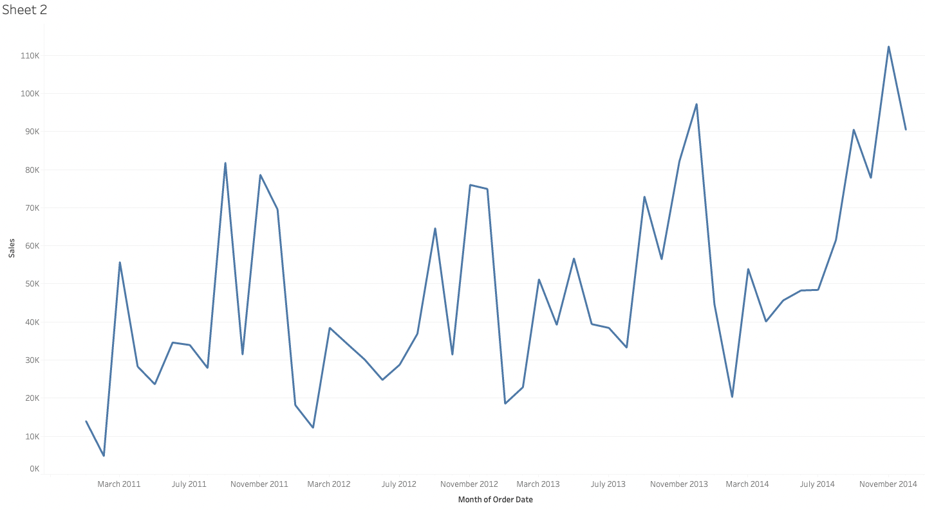
Continuous Dates

Slide 9
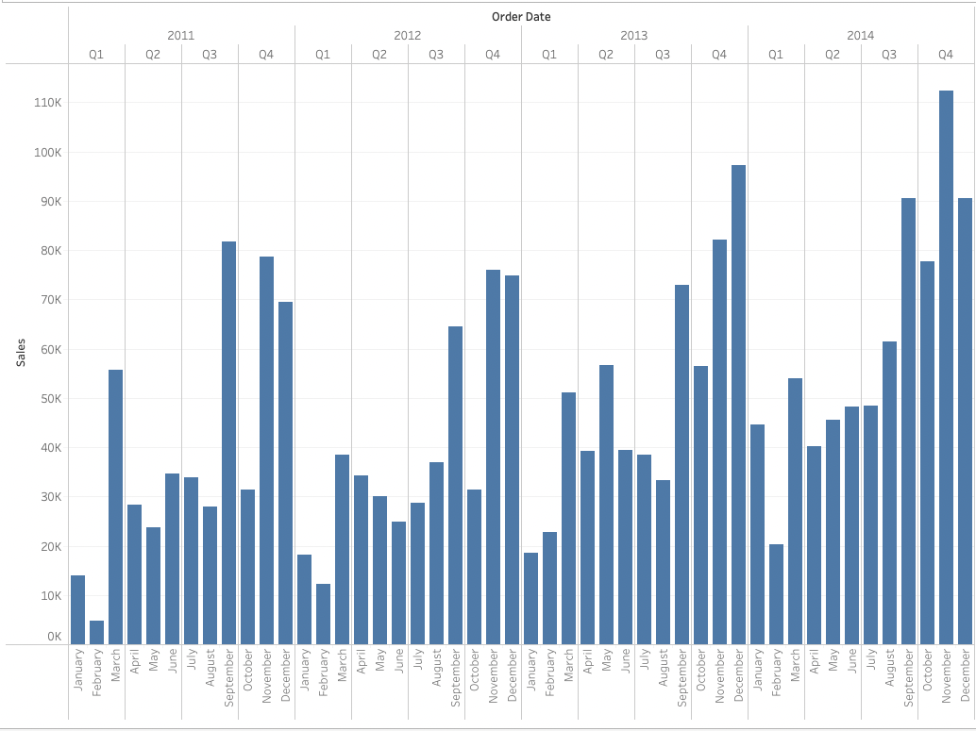
Discrete Dates

Slide 10
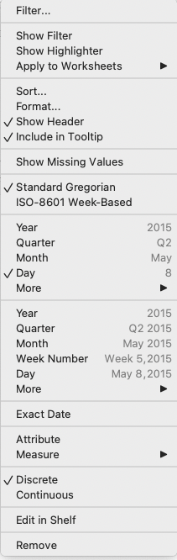
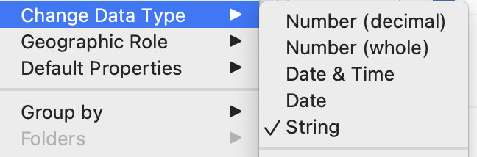
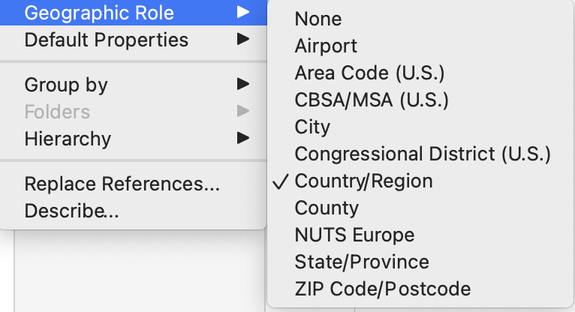
Changing Data Types

Slide 11
Organizing: Hierarchies, Groups, Sets
Hierarchies: groups together data in a way that allows you to “drill down”; like a Russian Doll; i.e Country, Region, City, Zip Code
Groups: more loosely defined; can take a number of dimension categories and collapse them into one
Sets: collections that have membership based on a condition; in/out
You can create these by right clicking on the field in the Data Tab

Slide 12
Chart Types
Line Graph : Two continuous variables or measures; usually showing how continuous variable changes over time
Scatter Plot: Two continuous variables and their relationship to one another; shows a possible correlation between two variables
Bar: One categorical variable and one continuous variable; the height of the bars is proportional to the values they represent
Geographical Map: Displays geographic data by categories or values
Dual-Axis Charts: Show multiple mark types on a shared axis

Slide 13
Marks Card
Drop down menu allows you choose which type of chart you want to create. The show-me tab also allows you to do this
Color, Size, Text, Detail, Tooltip
You can drag fields onto the cards to show different categories by size or color
You can also drag measures onto the size or color card to make the “functions” of the size or color spectrum, such as a heat map
You can add labels to measures by dragging fields onto the text card
You can use the tool tip to include or exclude data, or even add sheets to give more context to your visualizations.

Slide 14
Aggregations, Calculated Fields
You can aggregate measures once you placed them on the column or row shelf; Sum, Average, Median, Count, Count (Distinct)
The default aggregation will be SUM; you can change this by right clicking on the “pill”
You can create new fields out of existing fields using mathematical operations logic, or built in functions in Tableau.
Quick Table Calculations allow you to change a measure into built in calculation : running total, moving average, percent of total, difference etc
Right click the pill to select a quick table calculation; select the drop down menu at the top of your data tab to create a calculated field

Slide 15
Analytics Tab
You can add reference lines to give more clarity to your visualizations.
Average lines are already given as well as box plots
You can also add a custom reference line i.e a specific date or a range of dates such as the holiday season
You can also add forecasting to your visualizations if you want to predict how a measure would change in the future; almost always done with a line graph
The forecast will show a line in the middle of a shaded range. The shaded range will be the confidence interval and the line is the average.
Drag the forecast icon into your sheet; right click your forecast, select forecast options to adjust the confidence interval or how far out you want the forecast to go

Slide 16
Dashboards
You can place your visualizations in one place using a dashboard
With your blank dashboard you can see the list of all your sheets in the dashboard tab; drag a sheet to your dashboard to add it
To move around your chart you must first select the layout tab and chose “floating”
If you have a filter on a particular sheet and you want to apply that to all charts on your dashboard, right click your filter on your dashboard, select apply to worksheets then selected worksheets.

